Slide 1
IBM Capstone Project Battle of neighborhood
Clustering of the Property Sites in Brooklyn

Slide 2
Business Problem :
Finding a suitable property in the urban city is a very difficult job. One does not have enough time to invest in searching property plus sometimes real estate agents also hide information from the client which later become issue for the client. There are problems such as: hidden price falls, record-low sales, homebuilder exodus and tax hikes addressing overseas buyers of homes in Brooklyn.
How could we provide support to homebuyers clientele in to purchase a suitable real estate in Brooklyn keeping clients basic needs in mind?

Slide 3
Solution :
To solve this problem we will make clusters of the property based on the basic amenities and essential facilities surrounding such venues i.e. elementary schools, high schools, supermarket & restaurants.

Slide 4
Data collection :
Data on Brooklyn property and its price were extracted from the New York Government site (http://www1.nyc.gov). The attributes of the file contain Borough, Neighborhood, Building class category, Address, Price, Year built.
Link: https://www1.nyc.gov/assets/finance/downloads/pdf/rolling_sales/rollingsales_brooklyn.xlx

Slide 5
Methodology :
The Methodology section comprises four stages:
1. Explore data
2. Data preparation and preprocessing
3. Modeling
4. Analyzing Cluster

Slide 6
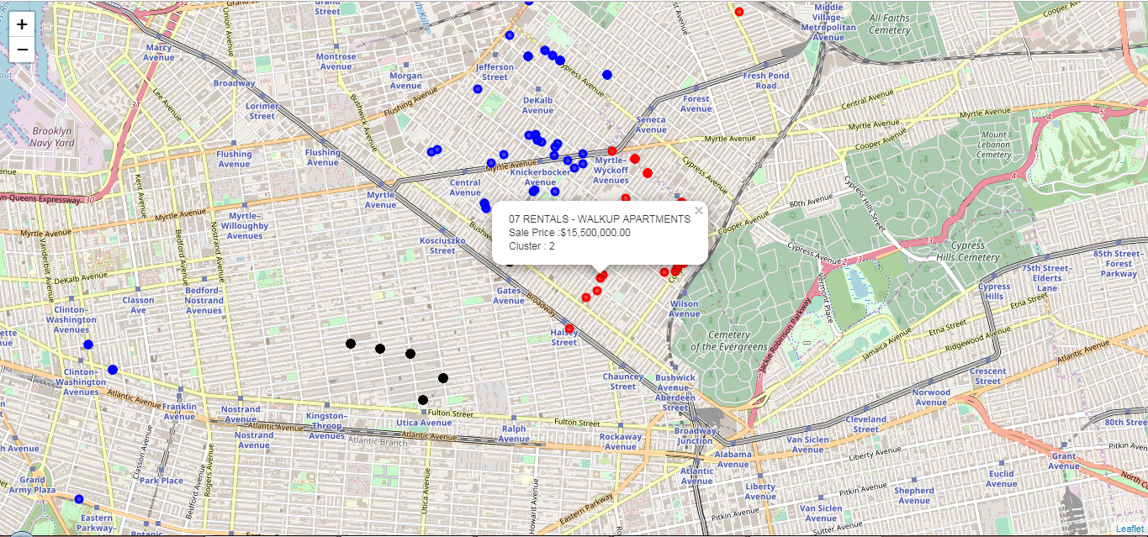
K- Means Clustering :
Cluster 0
Cluster 2
Cluster 1

Slide 7
Result :
Custer 0: In this cluster most of the common venues are bars, coffee shops, wine shops and yoga studio. There are few restaurants also such as Italian Restaurants. So we can say that a person who likes to do party and love wine will love this property.
Cluster 2: In this cluster most of the venues are restaurants such as Pizza place, Chinese Restaurant, Mexican Restaurant, Sandwich Place, Latin American Restaurant, Fried Chicken Joint and many more. There few Bar and Nightclub also. This cluster also have Supermarket and Grocery Store. This kind of property is very much likeable because every think is available in this area.

Slide 8
Conclusion
Final Conclusion of this report is that most of the property comes under the cluster 0 and 2 but most favourable property will be in cluster 2 because it contains all the basic amenities and essential facilities. Cluster 2 has better property as compared to cluster 0.
If we also see the price range of the property in both the clusters, Cluster 0 have a price range of 0.151 million dollar to 8.325 Miilion dollar whereas Cluster 2 have price range of 0.32 million dollar to 21.9 million doolar.

